Slide 1
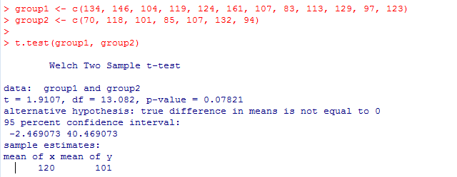
Interval estimation II: page 30-31 R

Slide 2
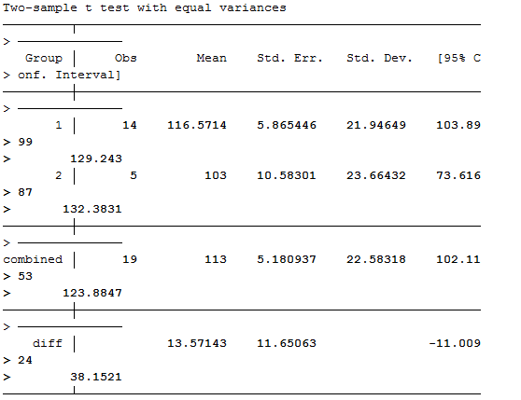
Interval estimation II: page 30-31 STATA

Slide 3
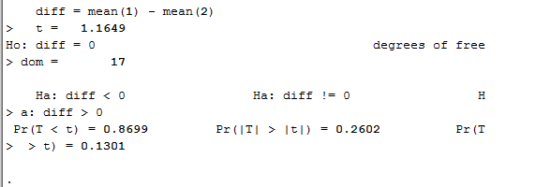
Interval estimation II: page 30-31 STATA

Slide 4
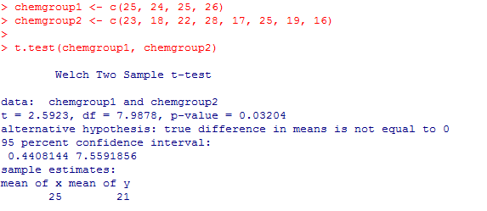
Interval Estimation II – R Page 34

Slide 5
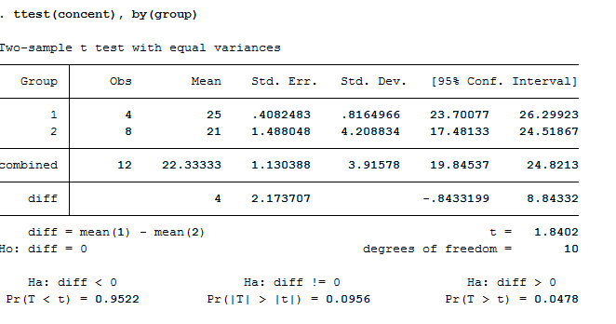
Interval Estimation II – STATA Page 34

Slide 6
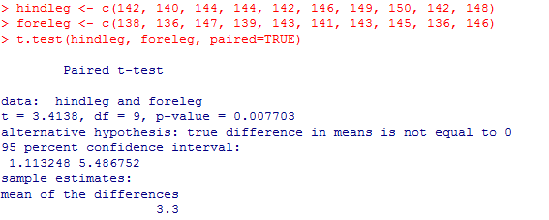
Interval Estimation II – page 38 R

Slide 7
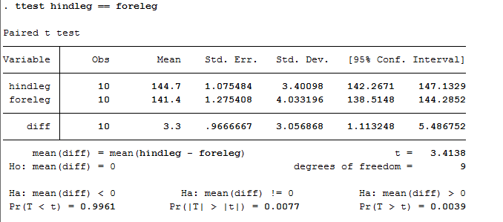
Interval Estimation II – page 38 STATA

